Slide 1
School Dropout Prediction Presentation
Predicting School Dropouts Using Machine Learning
Presented by: Blessing Ilesanmi
Date: 23rd October, 2024
Powered by 3Signet

Slide 2
Project Overview
Problem Statement
Goal: Develop a predictive model to identify students at risk of dropping out.
Objective: Provide early intervention to reduce school dropout rates using data insights.
Educational institutions need accurate predictive models to identify students at risk of dropping out
Why Dropout Prediction Matters:
Dropouts affect individual future success and society (unemployment, poverty).
Early identification enables educators to take proactive actions.

Slide 3
Dataset Overview
Data Source: 3Signet
Data Description: Dataset has 4424 rows and 37 columns with no missing values
Relevant Features:
Previous Qualification Grade
1st and 2nd Semester Curriculum details
Financial Data: Debtor, Scholarship holder, e.t.c
Age at enrollment

Slide 4
Data Preparation
Data Cleaning: Identify outliers and addressed outliers by capping them
Data Transformation:
Normalise numerical variables
Encode categorical variables

Slide 5
Key Findings
Students with higher previous qualification grades are less likely to drop out than those with lower qualifications.
Dropout rates are lower among students receiving financial aid or scholarships
Students who are debt-free have lower dropout rates compared to those with outstanding debts.
Students with up-to-date tuition payments are less likely to drop out compared to those with overdue payments.

Slide 6
Modelling Approach
Problem Type: Classification
Algorithms Tested:
Logistic Regression
Decision Tree
Random Forest
XGBoost
Support Vector Machine (SVM)

Slide 7
Model Performance
Evaluation Metrics: Accuracy, Precision, Recall, F1-Score.
Logistic Regression 0.760452 0.743781 0.760452 0.743407 0.875942
Decision Tree 0.696045 0.698928 0.696045 0.697114 0.737039
Random Forest 0.767232 0.752062 0.767232 0.753082 0.873943
Support Vector Machines 0.749153 0.736490 0.749153 0.735353 0.876137
XGBoost 0.771751 0.758692 0.771751 0.762171 0.872406

Slide 8
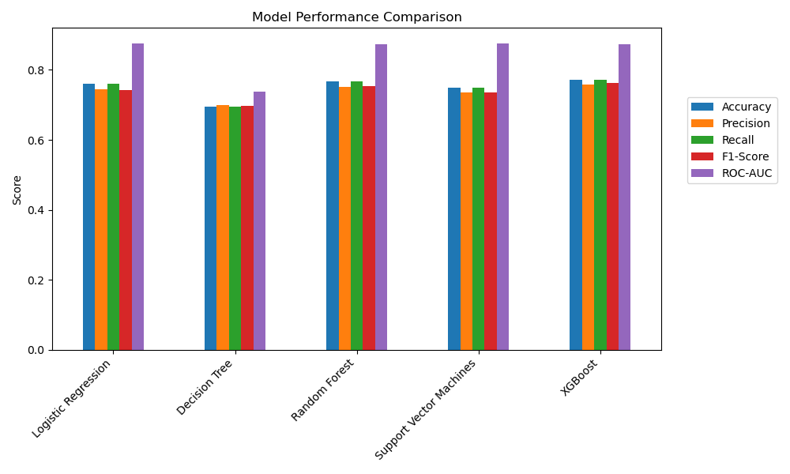

Slide 9
Final Model Selection
Best Model: Random Forest with 77% accuracy
Chosen Model: Random Forest
Why:
High interpretability and feature importance analysis.
Good balance of accuracy and recall.

Slide 10
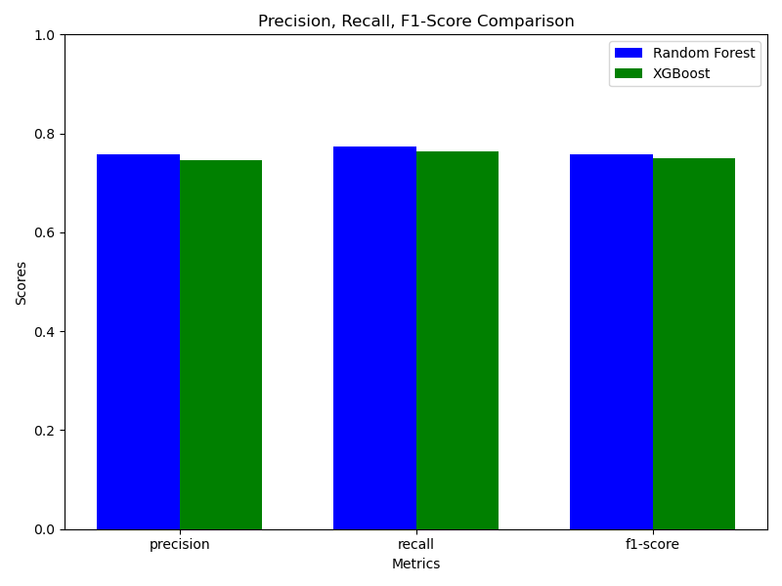

Slide 11
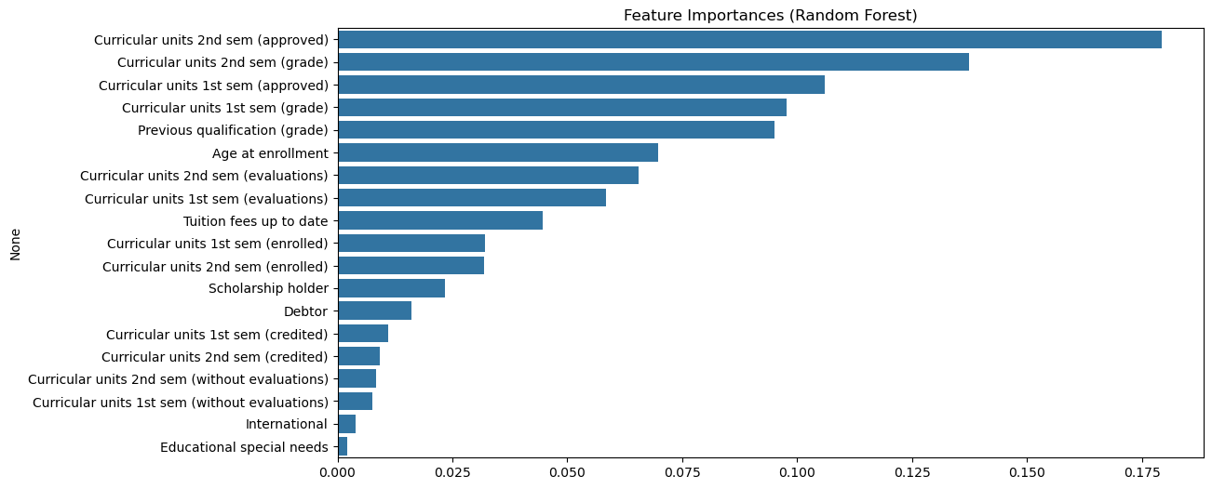

Slide 12
Deployment – Streamlit Web App Live Demo

Slide 13
Recommendations
Provide academic support for students with lower qualifications.
Expand financial aids and scholarship program.
Encourage tuition payment with flexible payment plans.
Conclusion
Dropout prediction model identifies at-risk students early for timely intervention.

Slide 14
Thank You

